Slide 1

ANNEX 1. Drawings
Legend | Description |  | No.
 | 900x2000 Lockable from outside |  | R1, L1
 | 900x2000 | Lockable from both sides, 400w x200h vent hole with fins | R1, L1
 | 800x2000 |  | R4
 | 800x1000 2 piece, 1 outside open, latch, burglar bar inside, |  | 2
 | 400x300 Ventilation with fixed fins |  | 6
 | Stool bowl, 4in PVC pipe 1400 |  | 2
 | Crouching seat, 4in PVC pipe 1400 |  | 4
D1
D1
D1
D2
3000
Men Site
D3
Women Site
7000 C/C
W1
D3
D3
D3
D2
D2
D3
200
W2
2000
W2
W2
W2
W2
W2
W2
2000
Notes:
Walls
1. All walls shall be made of well burned bricks with thickness of 200mm.
2. Lay 3 courses in English Cross . After 4th course of bricks, use brick conforce (force wire).
3. Apply plaster 18mm from floor to ceiling internal, and 15mm for external walls.
Toilet Rooms
1. Finished wall shall be shining.
2. Wastewater shall not come out from the door. Spilled water shall go into either shower drain or sitting hole.
3. Shower nozzles can be small but tamper resistant.
4. Attach a hook inside all D2 and D3 doors.
5. Place a shoe rack and additional hook on the wall in shower rooms.
6. Make threads around 4in PVC pipes and tighten tying wires on upper portion where embedded in the slab.
1500
1500
1500
2000
2000
1500
10000 C/C
TITLE：
Plan View
DATE： August 2021
Toker Hospital Toilets and Septic Tank
Mohammed Abdalla

Slide 2
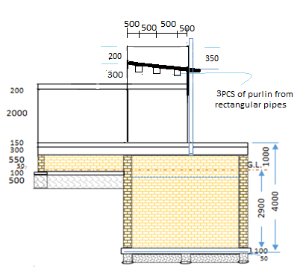
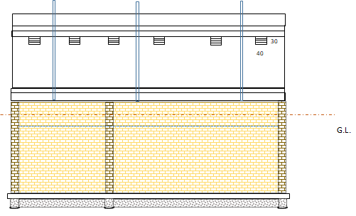
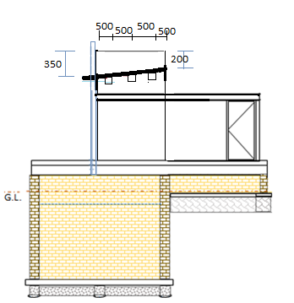
Ring Beam
Slab
Base Beam
G.L.
Front Right
Rear Left
TITLE：
Elevation Views
DATE： August 2021
Toker Hosbital Toilets and Septic Tank
Mohammed Abdalla

Slide 3

Bottom Slab Plan View
300
Notes:
1. Size of excavation (11,500L x 5,500W x 3,000D) allows 600 working space between lining and soil walls for plastering and painting.
2. Make the bottom completely flat. No filling back allowed.
3. Apply blinding 50mm.
4. Draw wall lines and set dual 16^{φ} Y-bars along the lining and partition walls. Lay Conforce 86 and tie with Y-bars each other.
5. 2 holes on the partition wall is 2340mm from slab and the bottom of outlet drainage pipe to soak away is 2600mm from the slab that is the working level in septic tank.
6. Finish the top of lining completely flat.
7. Plaster 25mm in and out of all walls.
8. Paint 2 coats of bitumen in and out of lining.
9. Fill gaps around lining layer by layer and compact it each time until completely filled up to ground level.
11500
Bonding mortar max. 15mm
Excavation Line
A2
Brick-force every 4 courses
Drainage to Soak Away
Sitting Hole Pipe
Shower
Well burned ordinary brick
2000
GL－3050
1:2:4 Reinforced Concrete
G.L.
A1
150
Conforce 86
200
Working Level
5500
4000
Holes
Hand Wash Basin
A1
50
1:3:6 Plain Concrete
2600
2000
GL－3300
1:2:4 Concrete
300
8mm^{φ} Ring, 200mm c/c
A2
6 No. 16mm^{φ} Y-Bar
3500
6500
300
Section A2-A2
Foundation & Wall
10000
Section A1-A1
Pit Wall Plan View
2 No. 500x500mm Concrete Manholes in 100mm thick slab
200x300 RC Beam with 6 No. 16mm^{φ} iron bars. See Beam Plan View
1000W x 800H Open partition
1000
2000
Primary Pit
G.L.
300
Coming from internal toilets of the Hospital
2 Holes
Working Level
4000
Brick Wall 300mm
Secondary Pit
5000
4000
2000
B1
B1
100mm RC slab with Conforce 86 on 50mm PC
3500
6500
2 coats bitumen on 25mm thick plastering
10000
Foundation Beam 300x300
Section B1-B1
TITLE：
Septic Tank
DATE：
Toker Hosbital Toilets and Septic Tank
Mohammed Abdalla

Slide 4
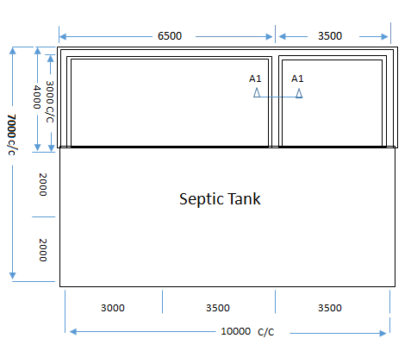
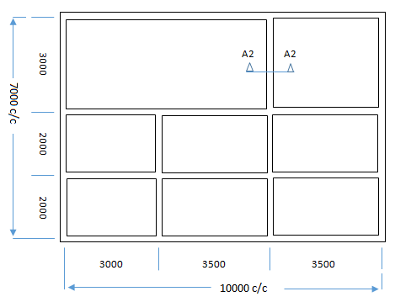
Base Beam Plan View
200
550
8mm^{φ} Ring, 200mm c/c
G.L.
150
1:2:4 R.C
4 No. 12mm^{φ} Y-Bar
Notes:
1. Start foundation excavation after refilling the gap around septic tank lining.
2. Bottom of foundation shall be very flat.
3. Fill hardcore pieces carefully, rammer on top, fill half with cement sand, repeat those up to 500 mm.
4. Lay beam with 4 bar and 1:2:4 concrete. The top shall be very flat and at ground level.
5. Top of foundation wall shall be leveled against septic tank lining.
6. Back fill inside foundation walls layer by layer with marram (rough sand), compact and repeat it up to top.
500
Granite Stone
≒ 100mm filled with cement sand
Notes:
1. Ends of iron bars shall be bent 90º and beam intersections shall be tied each other.
2. Forms shall be strong to resist wet concrete pressure.
3. Do not use much water to mix to minimize losing cement juice.
4. Vibrate thoroughly. No babbles allowed in beams.
6 No. 16mm^{φ} Y-Bar
300
1:2:4 Concrete
8mm^{φ} Ring, 200mm c/c
400
200
Section A1-A1
Section A2-A2
TITLE：
Plan Views of Foundation and Base Beam
DATE： August 2021
Toker Hosbital Toilets and Septic Tank
Mohammed Abdalla

Slide 5
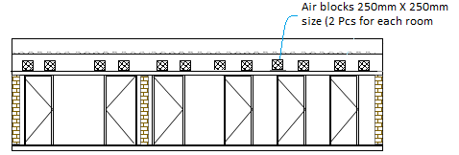
A1
A1
Hand Washing Basin Side A1-A1
A2
A2
Center of Door
200
Toilet Room Side A2-A2
100
200
200
Vent Hole on Door
TITLE：
Inside elevation views
DATE： August 2021
Toker Hosbital Toilets and Septic Tank
Mohammed Abdalla

Slide 6
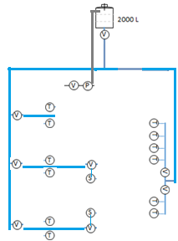
Water Supply System Diagram
Manhole Detail
Legend | Description | No.
 | Pump | 1
 | Shower Nozzle 1/2in | 2
 | Tap 1/2in | 12
 | Valve 1/2in 3/4in | 2 7
 | Pipe 1/2in GI (open)/PVC (buried)
 | Pipe 3/4in GI (open)/PVC (buried)
 | Pipe 1/2in GI (open)/PVC (buried)
V
V
P
S
V
T
P
V
V
V
V
V
V
Soak-away
RC with 10^{Φ} 150x150
Manhole Lid 450x450
100
Plan View
100
GL
Manhole Detail
Notes:
Water Supply
1. The first valve and the water pump shall be embedded under the terrace in front of overseer shelter’s door. The lid shall be steel so that easy to operate. The pump is operated by the switch on the outlet in the shelter.
Waste Water
1. Shower waste from women site goes into the septic tank straight.
2. Manhole on the merge from hand washing basins shall have sand trap that shall be cleared periodically.
Soak Away
1. Lay ring blinding as thick as 50mm in the bottom of the soak away.
2. Soak away lining is made of bricks. Bottom half shall be honeycomb that have 3 small spaces each course to let waste go out.
3. Outside over the GL shall be plastered.
700
Brick
Soil
DPM
Soak-away
Chamber
Slab
150
4” PVC from Septic Tank
From Septic Tank
Outlet
5000
Honeycomb Brick
Hardcore (150mm gauge)
Inlets
1550
400
Brick
50
100
1000
100
400
400
100
1000
100
400
2000
2000
TITLE：
Water, Drainage, and Soak Away
DATE： August 2021
Toker Hosbital Toilets and Septic Tank
Mohammed Abdalla

Slide 7

Cabling
Legend | Description | No.
 | Utility Power Meter | 1
 | Distribution Box | 1
 | Light (indoor) | 4
 | Light (outdoor, rain proof) | 4
 | Switch | 4
 | Outlet (single) | 1
 | Outlet (double) | 1
 | Water Pump 1/2in | 1
 | Float Switch (water tank) | 1
M
FS
M
DB
DB
P
Women Site
Men Site
P
Men Site
Women Site
P
FS
Notes:
Cables shall be buried in walls or roofs in conduit. The surface shall have no shades.
Set conduits for water pump under and through the slab.
Set conduits as necessary through the top beam.
The inlet tank is equipped with a float switch so that pump stops automatically when it becomes full.
Room Light Installation
Roof
200
Wall
250
TITLE：
Electricity
DATE：
Toker Hosbital Toilets and Septic Tank
Mohammed Abdalla

Slide 8
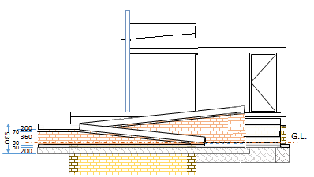
10000
1300
4200
1200
600
600
2100
Side View – Women Site
1500
4000
Curb
Slope 1/10
Steps
1400
Curb
2800
Curb
1400
Slope 1/10
Center of Door
1200
Women Site
Men Site
1200
G.L.
200T brick wall with brick force on 50T blinding under 200D x200W hardcore
200 x200 brick curbs on 70T RC bed with Con-force 86 on compacted marram (rough sand)
7900
4200
4000
Side View – Men Site
1300
900
Notes:
1. Works shall be commenced after the base slab level shall be defined.
2. The GL at each site to be confirmed again to set ±0 at the entrance of slope.
3. The inclination of slopes is 1/10 (6º).
4. The landing level of slopes shall be 43% of the base slab level from GL.
5. Slope walls and curbs to be plastered and painted.
TITLE：
Approach Slopes
DATE：
Toker Hosbital Toilets and Septic Tank
Mohammed Abdalla

Slide 9
Men Site
Women Site
100
100
100
800
100
800
100
100
400
400
400
400
450
700
700
700
450
400
700
400
3000
1500
Plan View
Elevation View
Side View
From Water Tank
150
150
400
700
400
700
400
400
400
400
150
150
To Manhole
Notes:
1. Water pipes and drainage pipes including manhole shall be embedded before the slab concreting.
2. Other works shall be commenced after building the outer walls.
TITLE：
Hand Washing Basins
DATE： August 2021
Toker Hospital Toilets and Septic Tank
Mohammed Abdalla

Slide 10
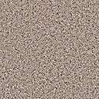
3000mm
3000mm
200mm Thickness
140mm
G. L
800 mm
400mm
600mm
Granite stone 400 mm Width Cement Mortar 1:6
G. L
400
Plain concrete1:3:6 100mm Thickness
Elevation and Section View
Title: Fence
DATE： September 2021
Shidyab Health Center - Fence
Harith Mohammed

Slide 11

North
A
150mm
3000mm
A
4600mm
3000mm
Section A-A
Notes:
Excavation size For Strip Foundation (600mm width and 500mm Depth).
Top of foundation shall be very flat.
Red Brick must be well burned and in standard dimension.
Brick wall 200mm Thickness , with 1:6 Cement mortar.
Brick Piers 400x400mm must be provided Every Three meters.
Smooth Plastering in and out
Painting with Pomastic at least three
layers
8. The western side of the fence should have 60 cm extra foundation depth
30000mm
15000mm
Title : Fence plan View
DATE： September 2021
Shidyab Health Center - Fence
Harith Mohammed

Slide 12
3000 mm
Angle steel section
70 x70x 5mm thickness
1000 mm
Lock
Angle section 50x50x5
1800mm
600x600mm Brick Piers
G.L
H Section steel posts 120X6 mm Thickness
400mm
500
PVC coated wire mish
500
Plain concrete 500x500x500mm
NOTES:
1. All Metal part shall be painted with primer coat of rust resistant.
2. PVC wire mish shall be full fixing on frame using pvc coated wire
Plain Concrete with slope 1:10 from Center to Edges
Angle section 50x50x5mm
Title : Gate View
DATE： September 2021
Shidyab Health Center – Fence
Harith Mohammed

Slide 13
Pit slab reinforcing plan
150mm thickness slab/ Ꝋ12
150 mm c/c
Bothway
5300
300
pit side view
A
A
2000 c/c
300
Section A1-A1
Base beam plan
4000 c/c
Top slab beam section
5600c/c
2000c/c
6 No. 16mm^{φ} Y-Bar
A1
300
1:2:4 Concrete
8mm^{φ} Ring, 150mm c/c
A1
300
TITLE：
Plan View
DATE： September 2021
Shidyab Health Center Toilet
Abdelkhalik Mahgoub

Slide 14
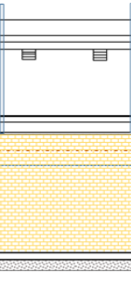
5000
3000
Rear view
Notes:
1. Size of excavation (5000L x 3,000W x 5,,000 D) allows 600 working space between lining and soil walls for plastering and painting.
2. Make the bottom completely flat. No filling back allowed.
3. Apply blinding 50mm.
4. Draw wall lines and set dual 16^{φ} Y-bars along the. Lay Conforce 86 and tie with Y-bars each other.
5. Finish the top of lining completely flat.
6. Plaster 25mm in and out of all walls.
7. Paint 2 coats of bitumen in and out of lining.
8. Fill gaps around lining layer by layer and compact it each time until completely filled up to ground level.
Notes:
Walls
1. All walls shall be made of well burned bricks with thickness of 200mm.
2. Lay 3 courses in Soldiering and every 4th course in Headers. After 2nd course of headers, use brick conforce (force wire).
3. Apply plaster 18mm from floor to ceiling internal, and 15mm for external walls.
Toilet Rooms
1. Finished wall shall be shining.
2. Wastewater shall not come out from the door.
3. Attach a hook inside all D3 doors.
4. Make threads around 4in PVC pipes and tighten tying wires on upper portion where embedded in the slab.
TITLE：
DATE： September 2021
Shidyab Health Center Toilet
Abdelkhalik Mahgoub

Slide 15
200
Notes:
1. Start foundation excavation after refilling the gap around pit lining.
2. Bottom of foundation shall be very flat.
3. Fill hardcore pieces carefully, rammer on top, fill half with cement sand, repeat those up to 500.
4. Lay beam with 6 bar and 1:2:4 concrete. The top shall be very flat and at ground level.
5. Top of foundation wall shall be leveled against septic tank lining.
6. Back fill inside foundation walls layer by layer with marram (rough sand), compact and repeat it up to top.
550
8mm^{φ} Ring, 200mm c/c
G.L.
150
1:2:4 R.C
4 No. 12mm^{φ} Y-Bar
Notes:
1. Ends of iron bars shall be bent 90º and beam intersections shall be tied each other.
2. Forms shall be strong to resist wet concrete pressure.
3. Do not use much water to mix to minimize losing cement juice.
4. Vibrate thoroughly. No babbles allowed in beams.
500
Granite Stone
≒ 100mm filled with cement sand
400
Section A2-A2
TITLE：
DATE： September 2021
Shidyab Health Center Toilet
Abdelkhalik Mahgoub

Slide 16
Bathroom plan
A2
4000 C/C
Legend | Description |  | No.
 | 900x2000 | Lockable from both sides, 400w x200h vent hole with fins | 2
 | 800x2000 |  | 2
 | 800x1000 2 piece, 1 outside open, latch, burglar bar inside, |  | 2
 | 400x300 Ventilation with fixed fins |  | 2
 | Stool bowl, 4in PVC pipe 1400 |  | 2
 | Crouching seat, 4in PVC pipe 1400 |  | 2
2000 C/C
1000
A2
D2
D2
D2
D3
D3
D3
W1
W2
W2
W2
Notes:
1. Water pipes and drainage pipes including manhole shall be embedded before the slab concreting.
2. Other works shall be commenced after building the outer walls.
TITLE：
DATE： September 2021
Shidyab Health Center Toilet
Abdelkhalik Mahgoub

Slide 17

Ventilation pipe-PVC 4'' Rectangular steel pipe (3*6)
Zinc Corrugated Sheet Rectangular steel pipe (3*6)
Truss Roof Top Level + 2.850
Truss Roof Bottom Level + 2.305
900
300
2.600
2.305
Ordinary red bricks wall(thick. 20 cm)
3.105
1.700
2.000
Crouching Seat
R.C. Roof Slab (150 mm) @15cm C/C
Floor Slab Level +600
900
600
Plain Concrete 125 mm
R.C Concrete beam 20*25 cm
800
400 250150
600
G.L + 0.00
G.L+ 0.00
500
500
Granite Stone Foundation 500mm
5600
400
400
Granite Stone Foundation
500 mm*400 mm with sand mortar
5000
Precast RC beam 250*200mm 4 No. 12
mm@15cm C/C,
300 mm Ordinary Brick wall
1.900
River sand 100mm Thick
with cement Mortar 1:6
R.C Ring 150mm Thick
P.C Ring 100mm
Thick Natural Soil
Hole bottom Level -5000
1000
1000
1200
4000
TITLE：
Plan Views of Foundation and Base Beam
DATE： September 2021
Shidyab Health Center Toilet
Abdelkhalik Mahgoub

Slide 18


Ventilation pipe-PVC 4''
Rectangular steel pipe (3*6)
Zinc Corrugated Sheet
2200
2300
2900
2.000
600
600
900
2200
.200 250
4100
TITLE：
Side Elevation
DATE： September 2021
Shidyab Health Center Toilet
Abdelkhalik Mahgoub

Slide 19
30000
1200
D2
2000
D3
2000
Ramp
1150
4000 C/C
4000
3350
D3
2000
D2
1200
2100
1200
1150
غرفة التحصين
4600
Ramp
مكتب التغذية
مكتب الدكتور
3450
15000
stairs
2550
1550
60
60
2100
8200
TITLE：
Top View
DATE： September 2021
Shidyab Health Center Toilet
Abdelkhalik Mahgoub

Slide 20
2500 mm
Angle steel section
50 x50x 5mm thickness
Lock
Angle section 25x25x3
1400 mm
Angle Section steel posts 70X70X7 mm Thickness
400mm
Plain concrete 100mm Thickness
Plain concrete 400x400x400mm
400
NOTES:
All Metal parts shall be painted with primer coat of rust resistant.
Title : Gate View
DATE： September 2021
Telegraib Health Center
Harith Mohammed

Slide 21

1000 mm
Angle steel section
37.5 x 37.5 x 3mm thickness
200 mm
Barbed Wire
150 mm
Tube steel section
60 x30x 2mm thickness
600 mm
NOTES:
All Metal parts shall be painted with primer coat of rust resistant.
Title : Fence View
DATE： September 2021
Marafeet Health Center
Harith Mohammed

Slide 22
Angle steel section
50 x50x 5mm thickness
1900 mm
Lock
Angle section 25x25x3mm
1800 mm
Existing Column
2mm thick steel plate
Title : Gate View
DATE： September 2021
Marafeet Health Center
Harith Mohammed

